Slide 1
LibreOffice Python - Part 2
Writing a Python Program for LibreOffice that is stored in the LibreOffice User library.
Hamilton Python User Group Presentation
2015 April 13
Ian Stewart
V1.0
https://github.com/hampug

Slide 2
Steps to create an example python program that is stored in a User's local folder - known as the “User library”.
Create a new Draw or Writer document and save to a file.
Add 2 x pushbuttons and a TextBox1.
Use a text editor to write the python program. Store in the User library: ~/.config/libreoffice/4/user/Scripts/python/
Link the Execute Action of the pushbuttons to their python functions in the locally stored python program in the User library.
Libraries available: User, Shared and Document. Using the User library is most suitable for the development phase of a Python program.
…next 20 slides show the screen shots of doing the above.

Slide 3
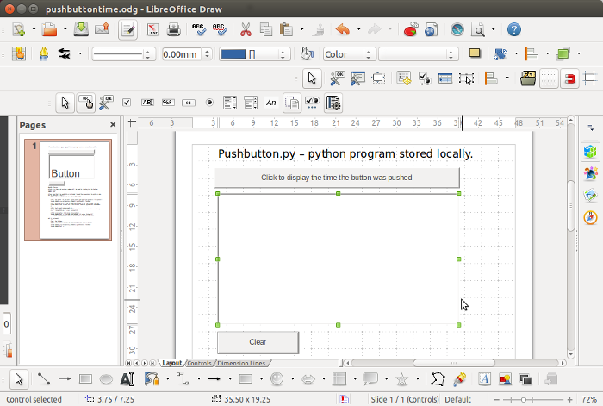
Create new LibreOffice Draw document. Add Controls: 2 x Push buttons, 1 x Textbox. Plus add a caption. Save.

Slide 4
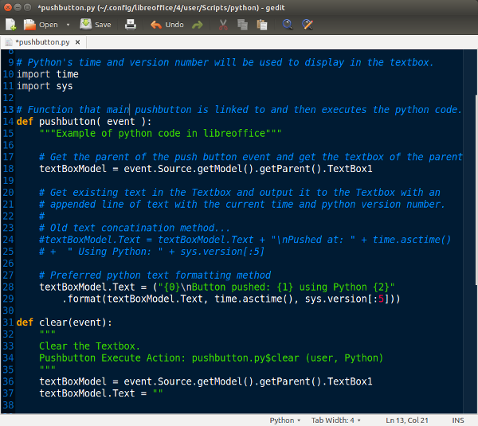
pushbutton.py python program saved in User macro library

Slide 5
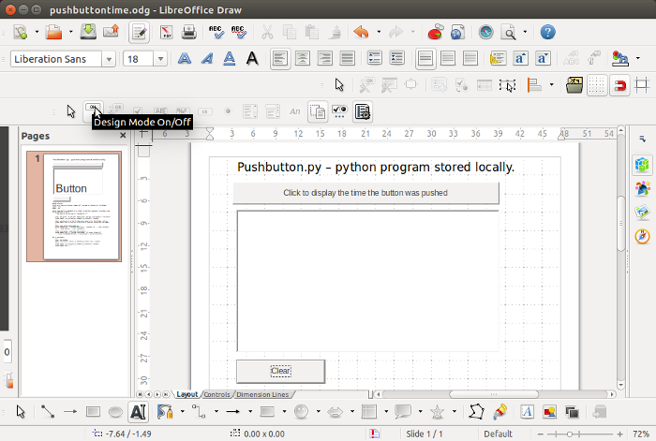
Linking 2 x Push Buttons to python code in the User library.
Turn on design mode...

Slide 6
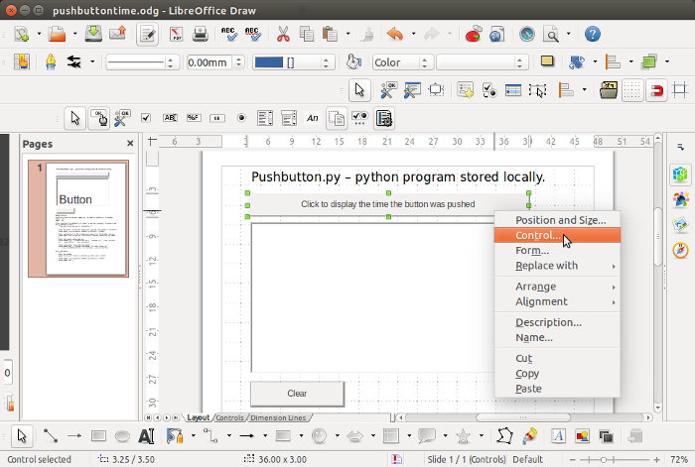
Link Push Button to python function. Modify Control

Slide 7
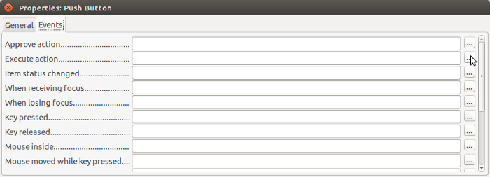
Select Execute Action for the Push Button

Slide 8
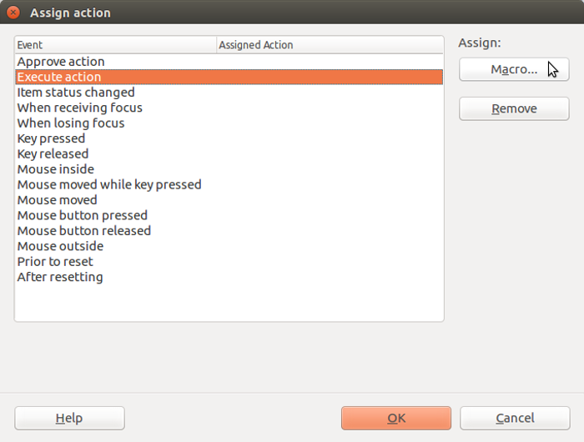
Assign Macro

Slide 9
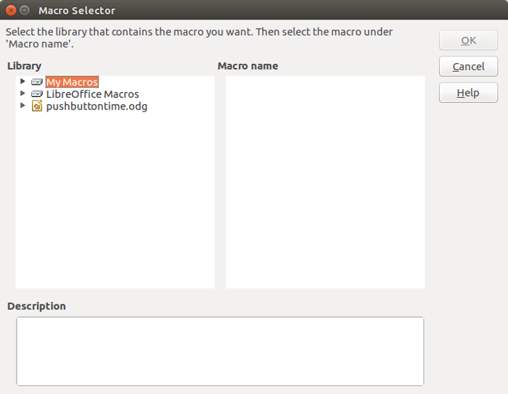
Select User Library macros. i.e. “My Macros”

Slide 10
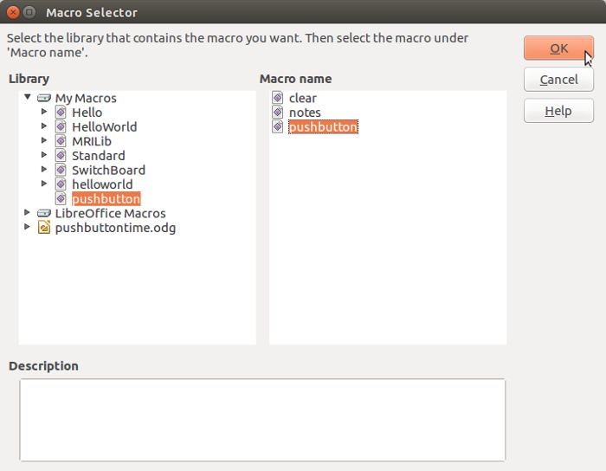
Select pushbutton function

Slide 11
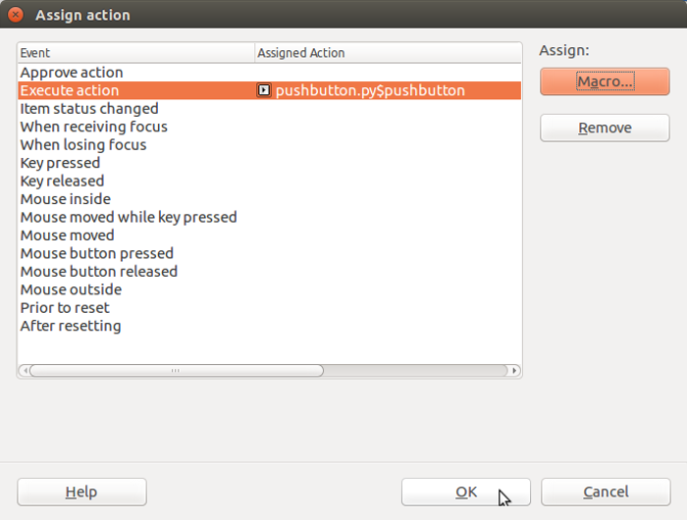
Function is now assigned ...OK

Slide 12
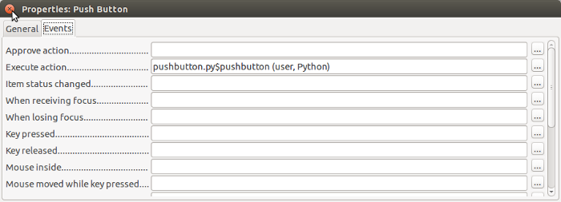
Review Execute Action is assigned. ...Dismiss.
Repeat the previous 6 slides for the “Clear” push button.
Both push buttons are now linked to functions in the python program located in the User Macro library.

Slide 13
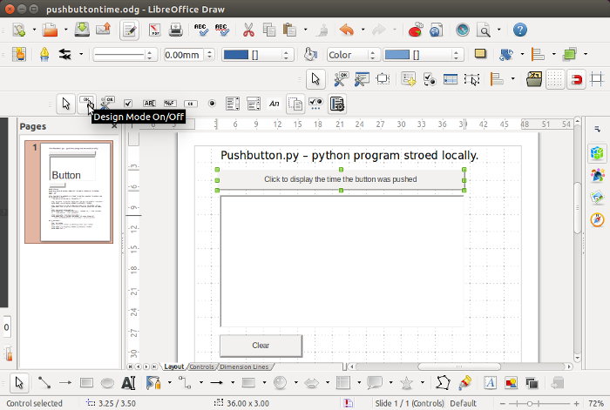
Turn off design mode in order to run the program.

Slide 14
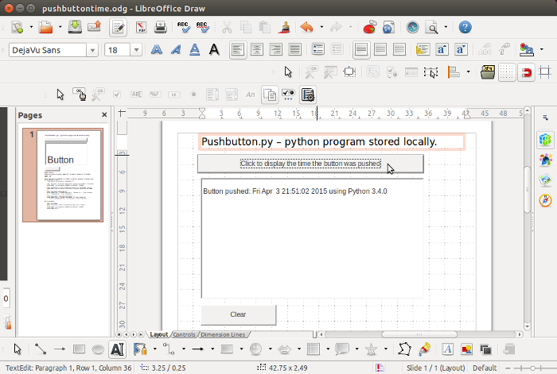
Run the program.
Click on the Push button, which executes the function, and provides output in the TextBox

Slide 15
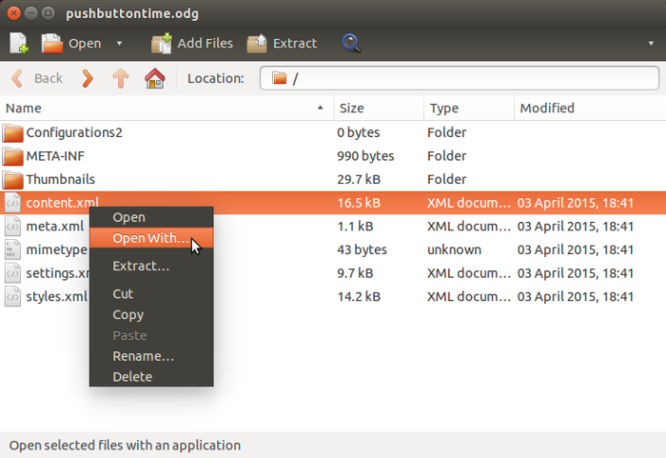
Review of the libreoffice file “pushbuttontime.odg” using archive manager. Open content.xml file with a text editor...

Slide 16
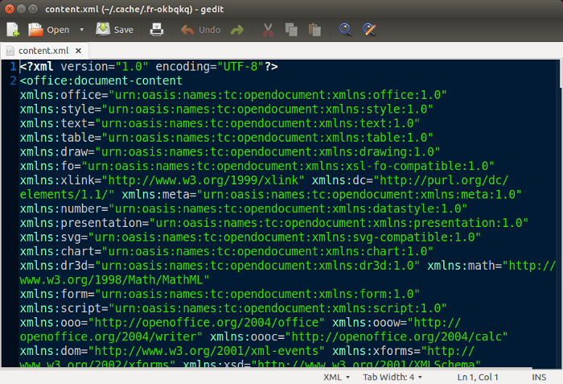
Review of start of content.xml file in editor

Slide 17
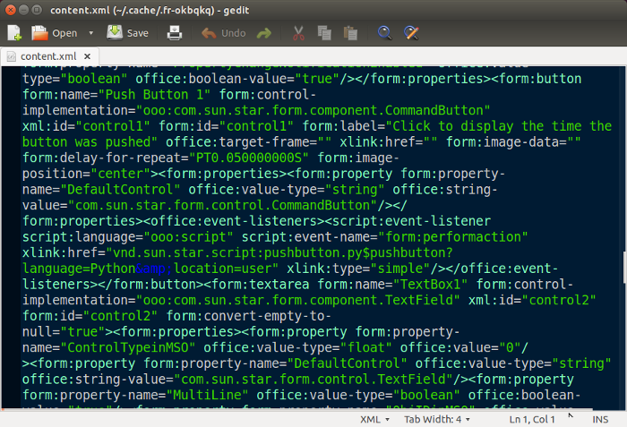
Review of pushbutton in content.xml file

Slide 18
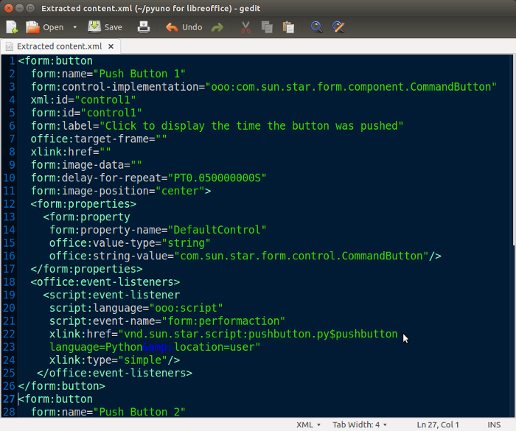
Improved view of pushbutton in content.xml file

Slide 19
Breakdown of Event-listener xlink in content.xml for Push Button 1 & 2:
xlink:href="vnd.sun.star.script:pushbutton.py$pushbutton language=Python&amp;location=user" xlink:href="vnd.sun.star.script:pushbutton.py$clear? language=Python&amp;location=user"
“pushbutton.py” is the name of the python program/module.
“pushbutton” is the python function for Push Button 1.
“clear” is the python function for Push Button 2.
“user” is the location ~/.config/libreoffice/4/Scripts/python/.

Slide 20
End of reviewing locally stored python file.
Goto Part 3 for system wide shared stored python files...

